Slide 1

FOREIGN DIRECT INVESTMENT
January 27, 2021
Sana Jalgaonkar
Video Explanation

Slide 2

Agenda
Introduction
Problem Statements
Dashboard
Results
Summary
Conclusion

Slide 3

Introduction
In this project, we will explore the FDI dataset and analyze it from the perspective of a business. We shall look at various sectors to determine which sector will prove most beneficial to collaborate with, for the company. The purpose of the project is to understand the Foreign direct investment in India for the last 17 years from 2000-01 to 2016-17
Data Source:-https://www.kaggle.com/rajanand/fdi-in-india
This dataset contains sector and financial year wise data of FDI in India.

Slide 4
Problem Statements
Which sector receives the maximum direct funding for a given year?
Which sector receives the minimum direct funding for a given year?
Is there a trend of direct investments for individual sector?
In what fashion can the sectors be grouped for comparisons?
Which sectors reported the highest growth in the past 5 years?
Which sectors reported the highest decline in the past 5 years?
Which sector reported the most variation overall?
What is the proportion of investment between sectors from the FDI perspective?
Are there any specific clusters present in the data?
Can we forecast the trend for the following year?

Slide 5

DASHBOARD AND RESULTS
Let’s dive in

Slide 6
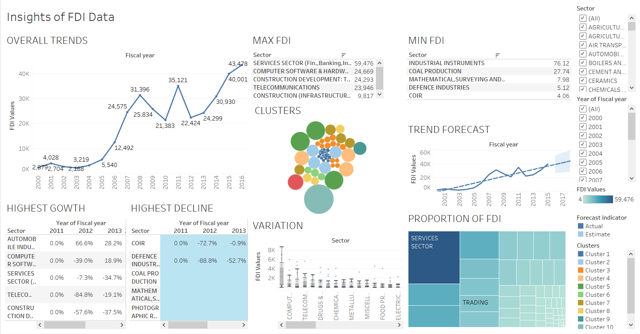

Slide 7
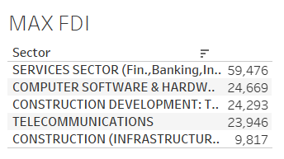
Which sector receives the maximum direct funding for a given year(2016)?
These are all the top 5 performing sectors that receive the maximum funding for the year 2016.

Slide 8
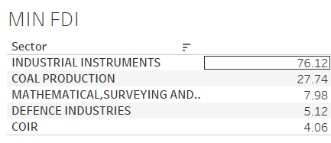
Which sector receives the minimum direct funding for a given year?
These sectors receive the minimum funding for the year 2016.

Slide 9
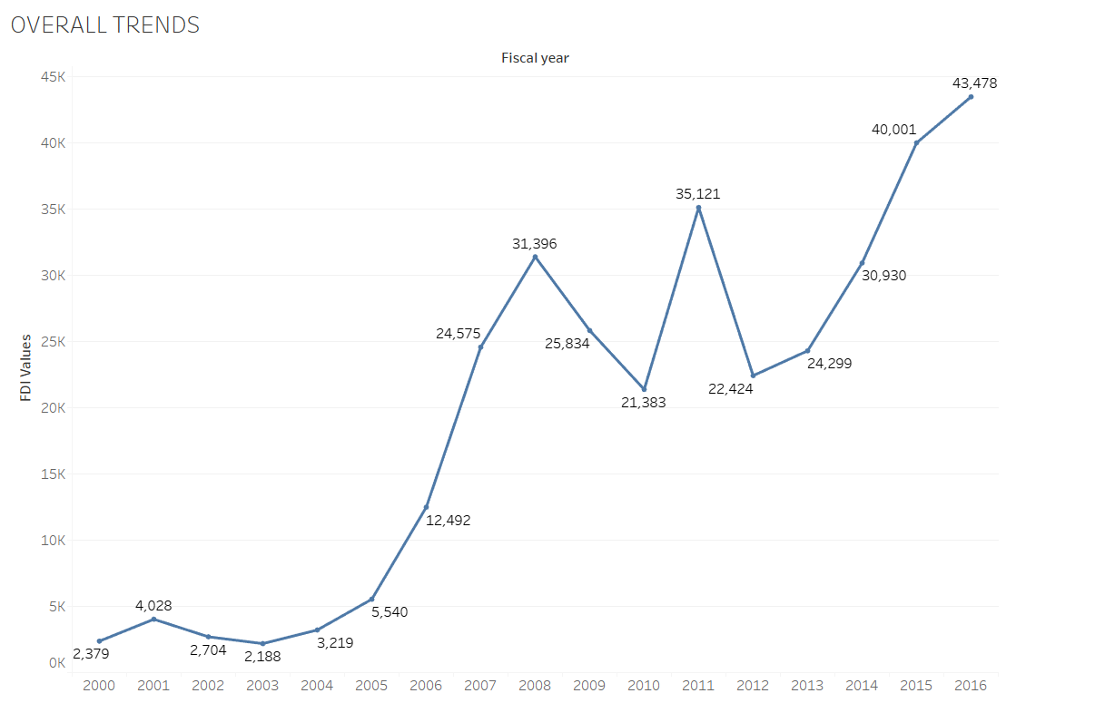
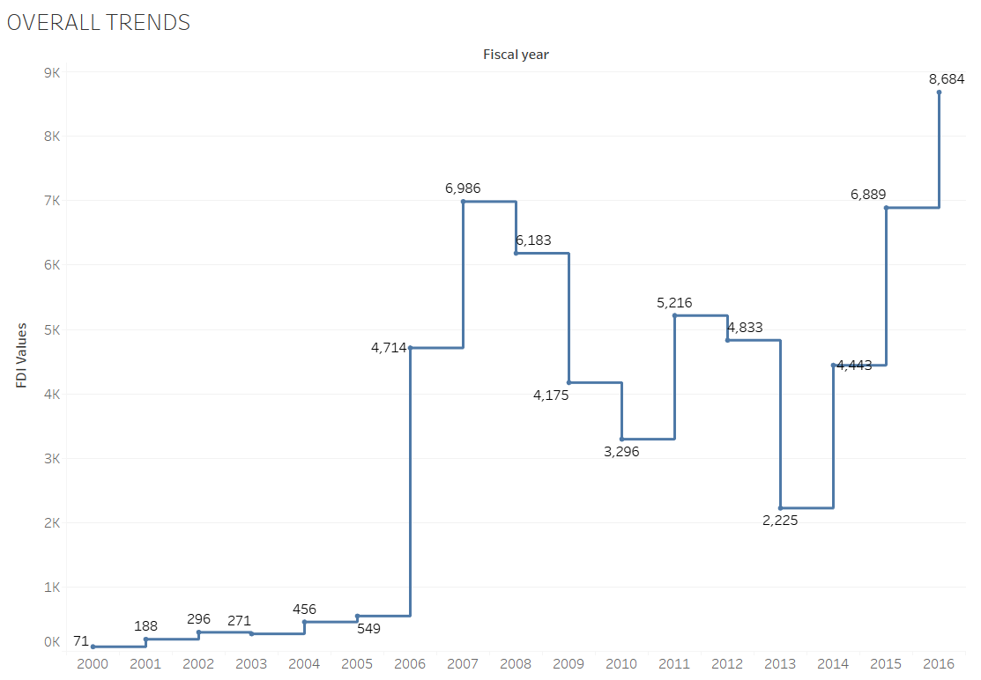
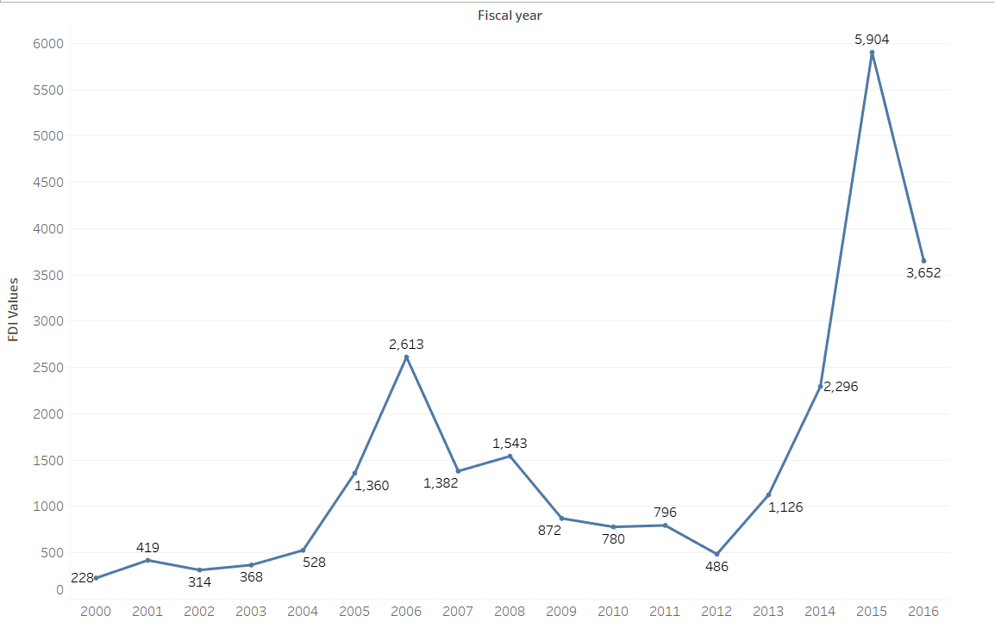
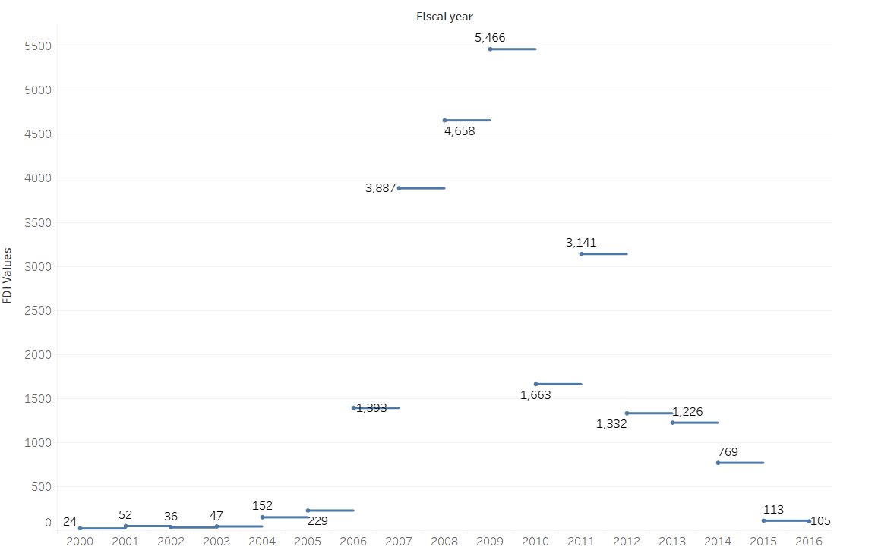
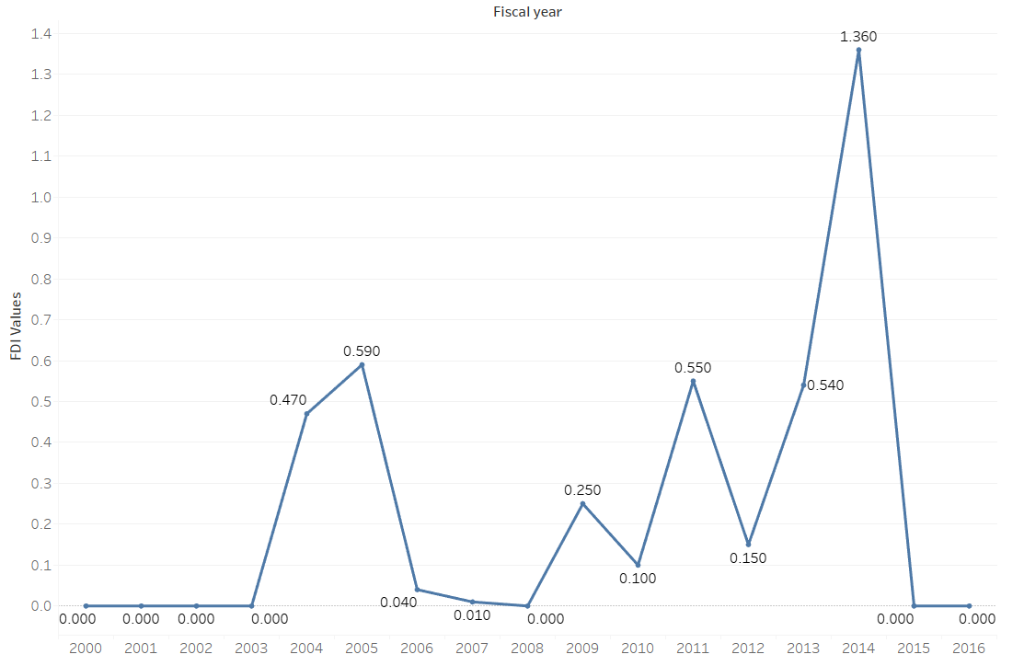
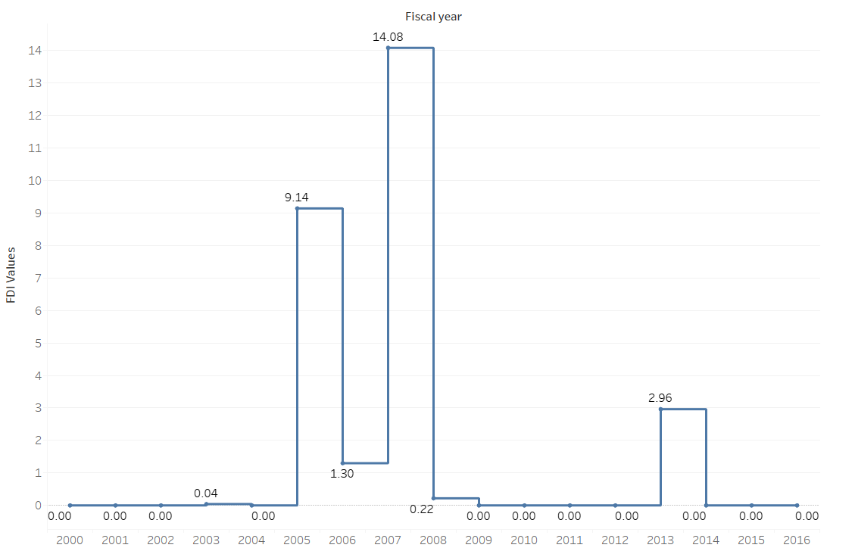
Is there a trend of direct investments for individual sector?
Trend for all sectors
Trend for Services Sector
Trend for Computers sector
Trend for construction development
Trend for Coir Sector
Trend for Coal Production

Slide 10
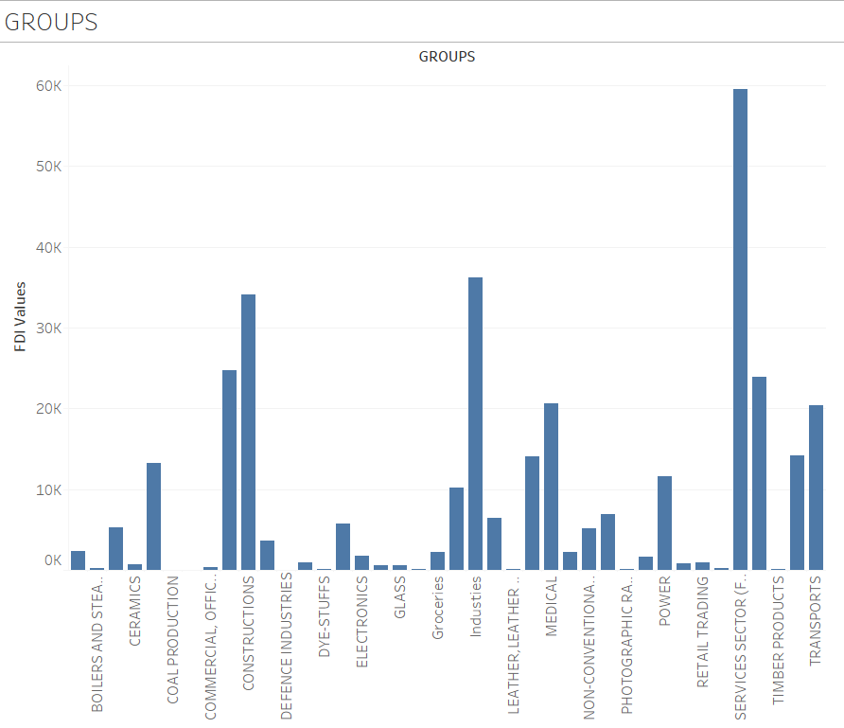
In what fashion can the sectors be grouped for comparisons?

Slide 11
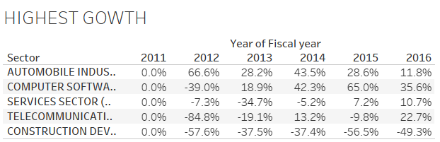
Which sectors reported the highest growth in the past 5 years?

Slide 12
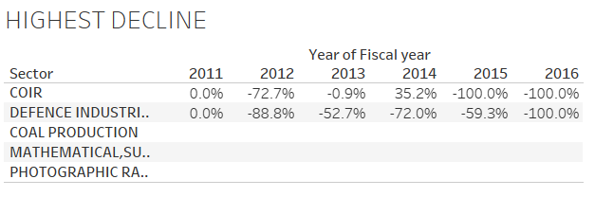
Which sectors reported the highest decline in the past 5 years?

Slide 13
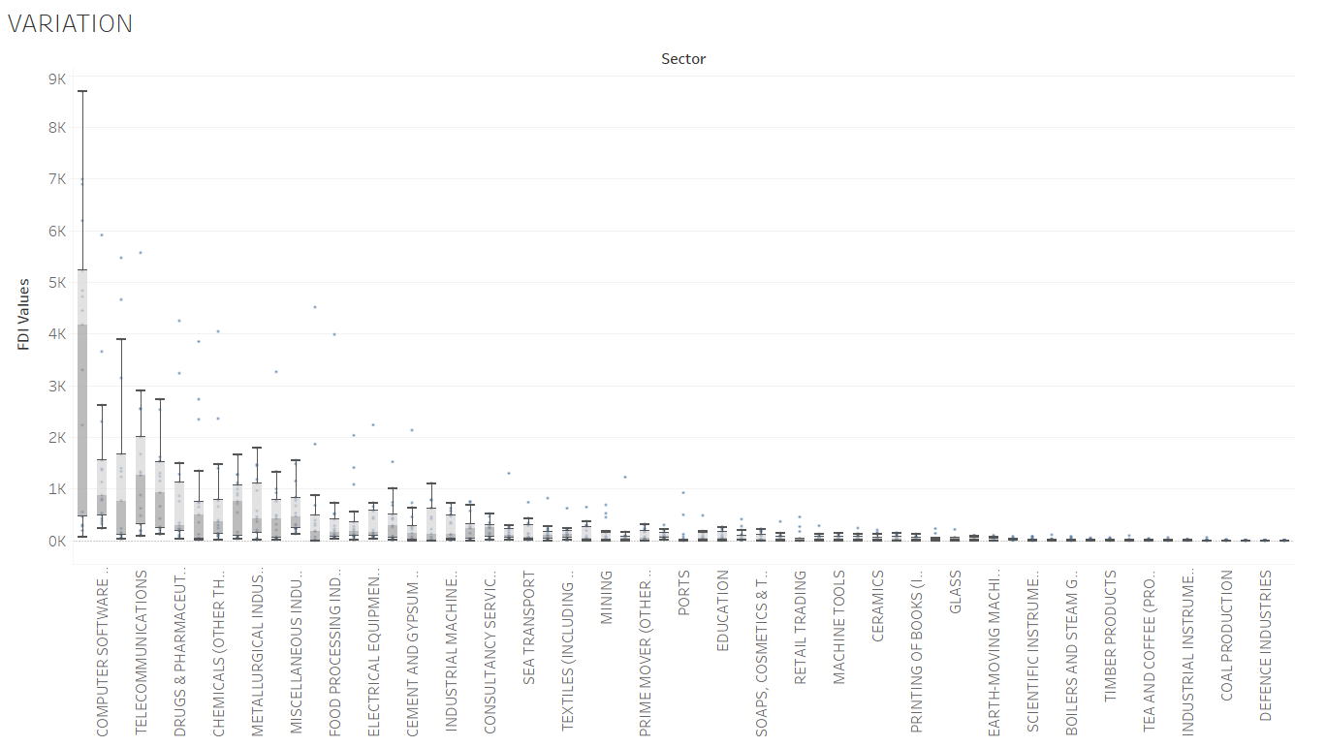
Which sector reported the most variation overall?

Slide 14
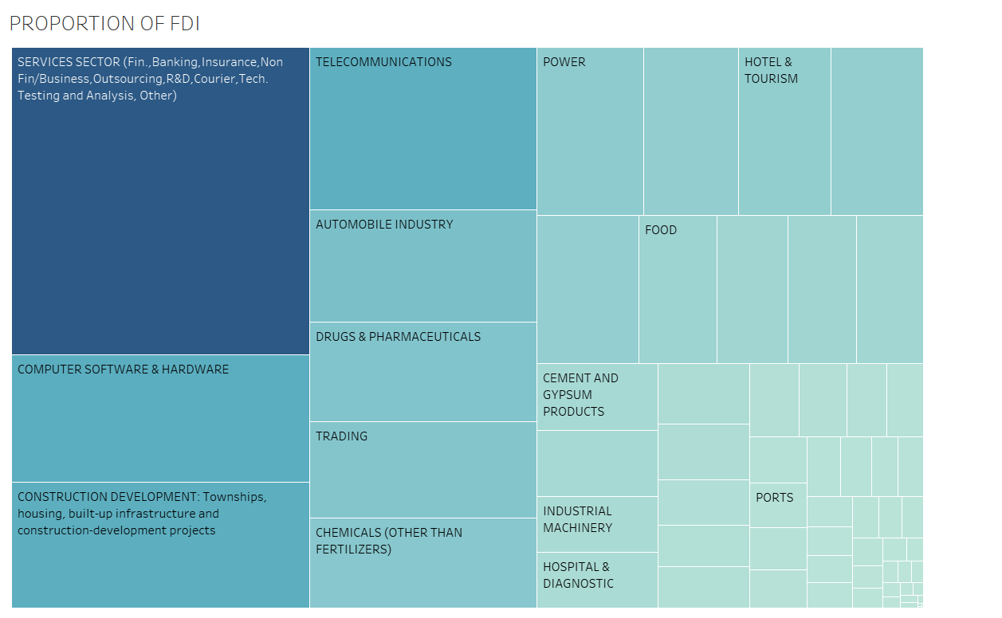
What is the proportion of investment between sectors from the FDI perspective?
We can see, the proportions of FDI over all years since 2000 to 2016 with the highest proportion for the sevices sector followed by computer software & hardware, constructions and so on.

Slide 15
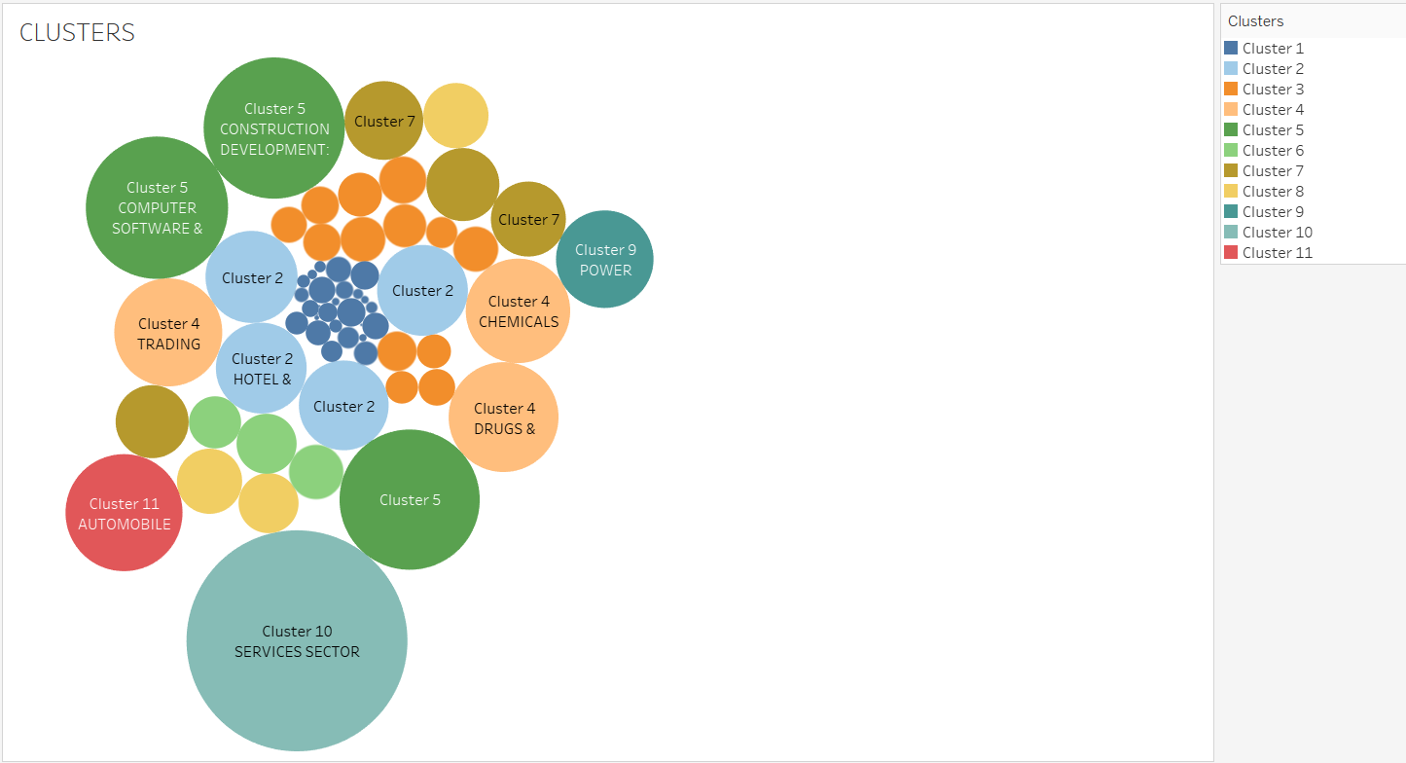
Are there any specific clusters present in the data?
We can see cluster 9 and cluster 11 has one cluster each while cluster 5 includes computer software & hardware, Construction development & telecommunication.

Slide 16
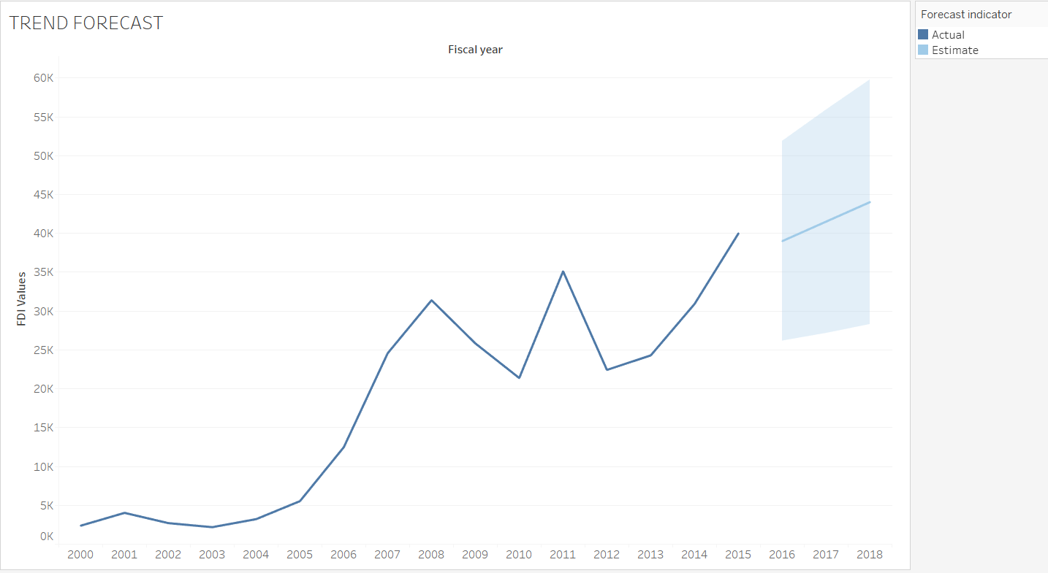
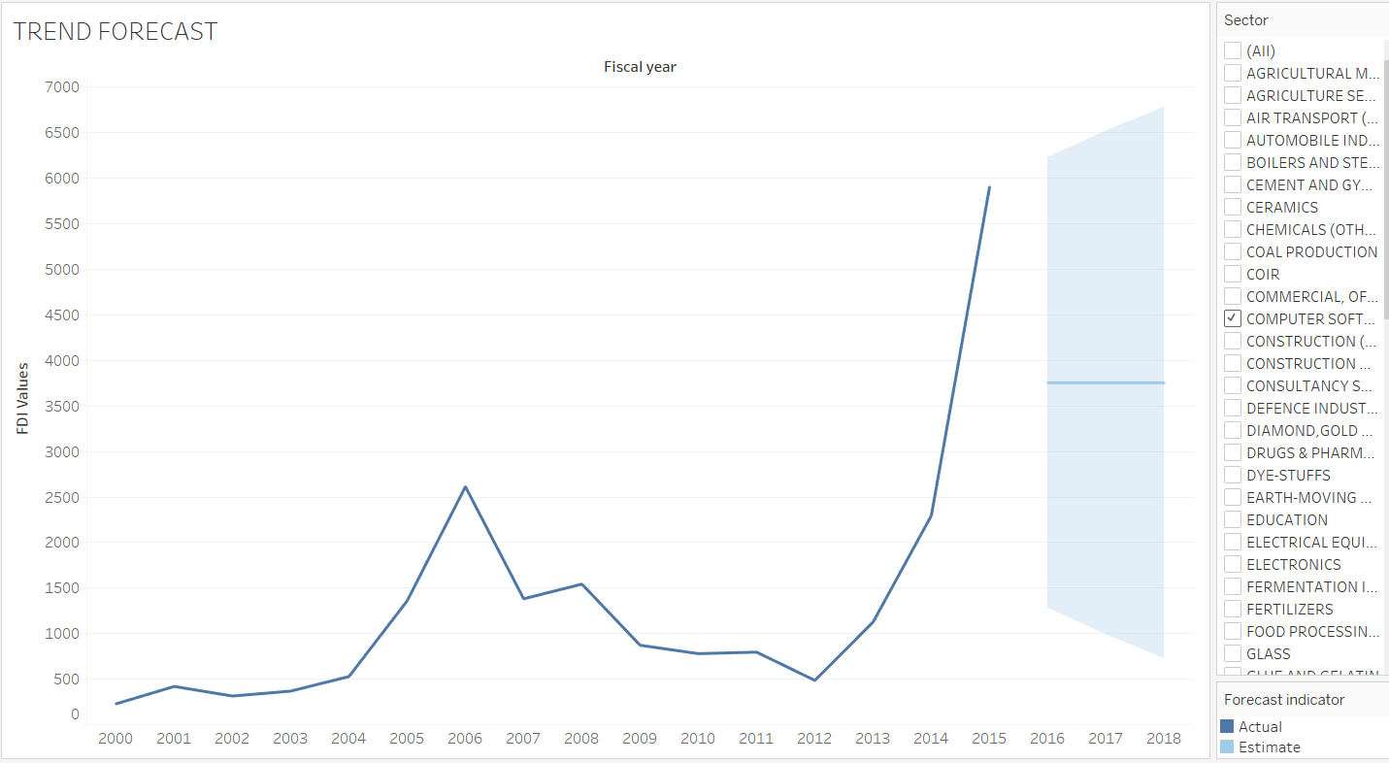
Can we forecast the trend for the following year?
FORECAST FOR OVERALL SECTORS
FORECAST FOR A PARTICULAR SECTOR(COMPUTER SOFTWARE & HARDWARE)
It says, By the end of 2016 values going to drop to 39,009 from 40,001 but will increase to 44,025 by the end of 2018.
It will almost go from 5,904 to 3,753.

Slide 17
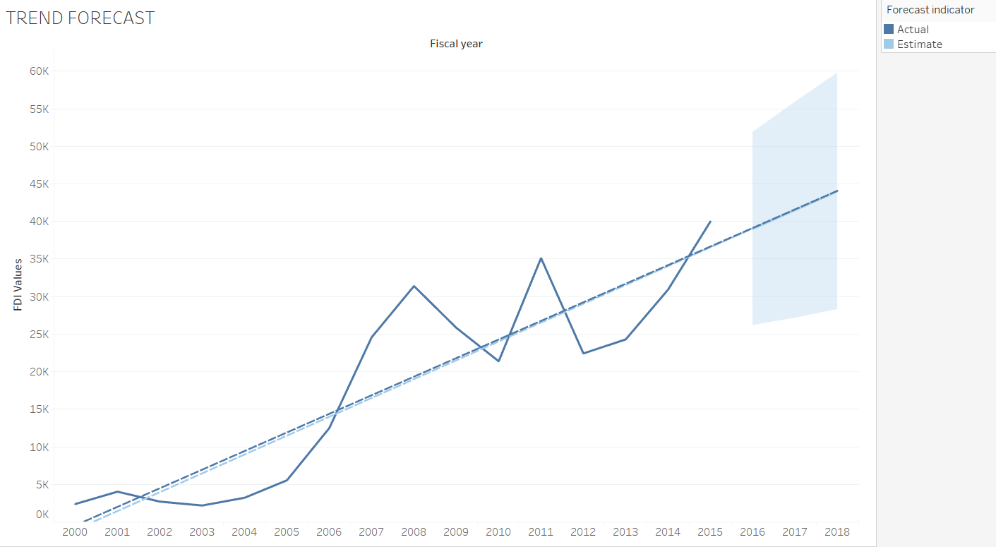
This is the linear trend line that is it basically is the linear equation which says to get the FDI values at any given certain points you’ll have to use the equation given for FDI value which is Prebid number.

Slide 18





Summary
As per the data, the sectors that attracted higher inflows were Services (17%), Construction activities (9%), Telecommunications (7%) and Computer Software and Hardware (7%).
After above analysis, we can say that FDI has good future growth in Retailing and Real estate sector in India.
FDI create high perks jobs for skilled employee in Indian service sector.
We are getting things done. The forecasting shows a linear increase for overall sectors with an initial slow to rapid progress.
Service sector is first and Computer Software & hardware sector is second segment of which pick the growth in second decade of reforms.

Slide 19

Conclusion
FDI is an important stimulus for the economic growth of India.
Computer, Software & Hardware and Drugs & Pharmaceuticals sector were the other sectors to which attention was shown by Foreign Direct Investors (FDI).
FDI has helped to raise the output, productivity and employment in some sectors especially in service sector.
Indian service sector is generating the proper employment options for skilled worker with high perks. On the other side banking and insurance sector help in providing the strength to the Indian economic condition and develop the foreign exchange system in country.
So, we can conclude that FDI is always helps to create employment in the country and also support the small scale industries also and helps country to put an impression on the world wide level through liberalization and globalization.
Sana Jalgaonkar
sanajalgaonkar2810.sj@gmail.com

